Slide 1
GROUP ACTIVITY - I
PRESENTED BY –
AABIR DATTA : 19BCE10062
ABHISHEK SRIVASTAVA: 19BCE10071
SUMAN GOYAL: 19BCE10386
VANIEKA SHARMA: 19BCE10310
JAHNVI KHANDELWAL: 19BCE10055
AAYUSHI SINGH: 19BCE10151

Slide 2
TYPES OF RESISTORS, INDUCTORS AND CAPACITORS

Slide 3
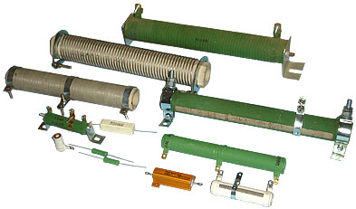
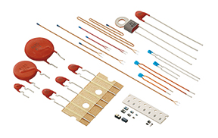
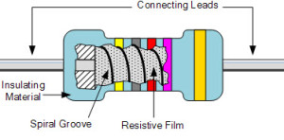
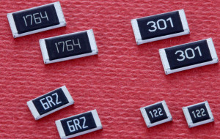
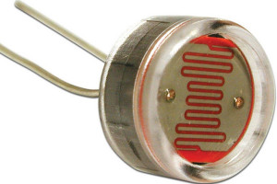
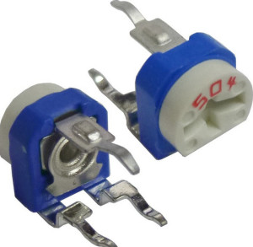
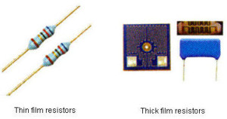
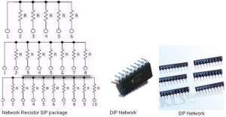
Types of Resistors
WIRE WOUND RESISTORS
METAL FILM RESISTOR
THERMISTOR
SURFACE MOUNT RESISTORS
VARIABLE RESISTORS
LIGHT-DEPENDENT RESISTORS (LDR)
THICK FILM AND THIN FILM RESISTORS
NETWORK RESISTORS

Slide 4

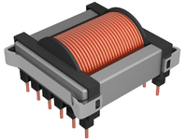
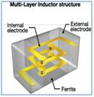
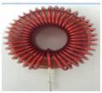
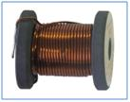

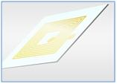
Types of Inductors
AIR CORE INDUCTORS
FERRO MAGNETIC OR IRON CORE INDUCTORS
MULTI LAYER INDUCTORS
FERRITE CORE INDUCTORS
TOROIDAL CORE INDUCTORS
BOBBIN BASED INDUCTORS
THIN FILM INDUCTORS

Slide 5
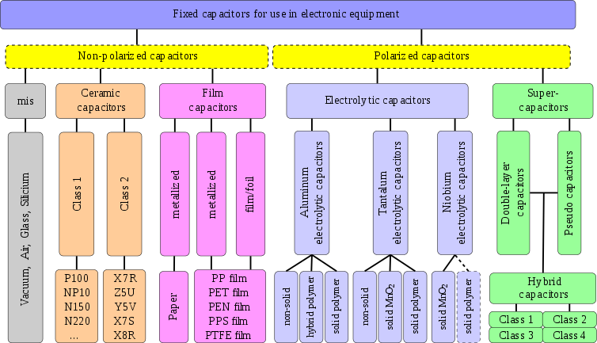
Types of Capacitors

Slide 6
MATHEMATICAL MODELS OF RESISTOR, INDUCTOR AND CAPACITOR

Slide 7


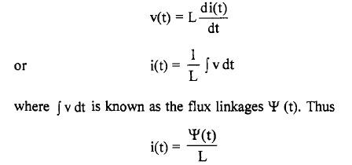
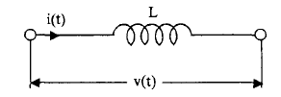

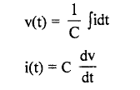

Resistor:
The mathematical model is given by the Ohm’s law relationship
Inductor:
The input output relations are given by Faraday’s law,
Capacitor:
If we integration of v(t) is known as the charge on the capacitor and is denoted by ‘q’. Thus

Slide 8
COLOUR CODING OF RESISTORS, INDUCTORS AND CAPACITORS

Slide 9
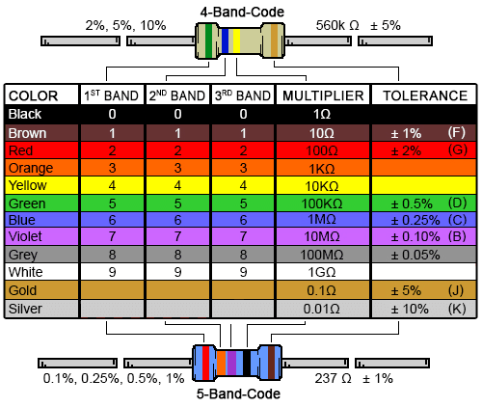
FOR RESISTORS

Slide 10
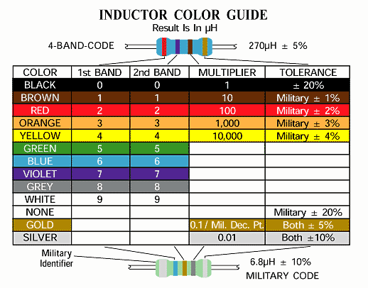
FOR INDUCTOR

Slide 11
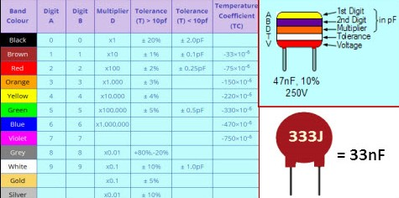
FOR CAPACITOR

Slide 12
I – V CHARACTERISTICS OF RESISTORS,INDUCTORS AND CAPACITORS

Slide 13
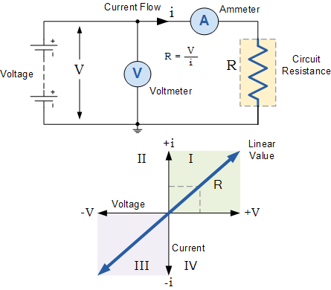
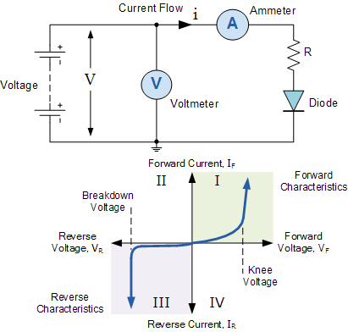
For Resistors
For an ideal resistor: The i-v characteristic curves defines the resistive element, in the sense that if we apply any voltage value to the resistive element, the resulting current is directly obtainable from the I-V characteristics. As a result, the power dissipated (or generated) by the resistive element can also be determined from the I-V curve.
When the diode is forward biased, anode positive with respect to the cathode, a forward or positive current passes through the diode and operates in the top right quadrant of its I-V characteristics curves as shown.
When the forward voltage exceeds the diodes P-N junctions internal barrier voltage, which for silicon is about 0.7 volts, avalanche occurs and the forward current increases rapidly for a very small increase in voltage producing a non-linear curve. The “knee” point on the forward curve.

Slide 14
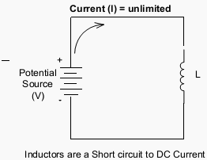
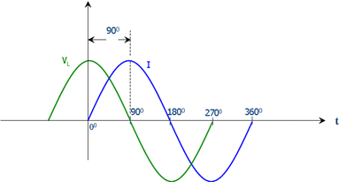
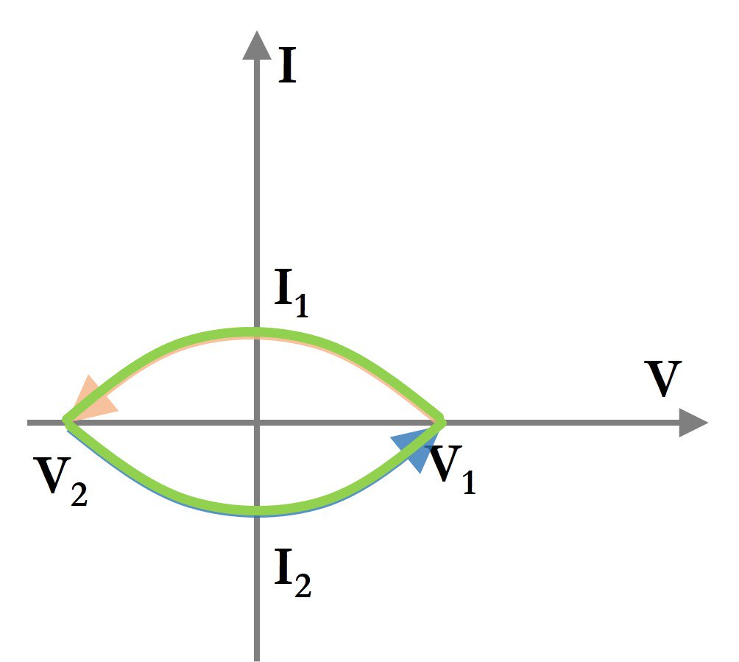
For Inductors
The amount of voltage that will be produced in an inductor depends on how rapidly the current through it will decrease. The induced voltage will be opposed to the change in current as described by Lenz’s Law. The voltage polarity will be oriented to keep the current at its former magnitude with a decreasing current. The only difference between the effects of a decreasing current and an increasing current is the polarity of the induced voltage.

Slide 15
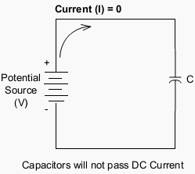
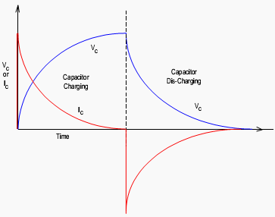
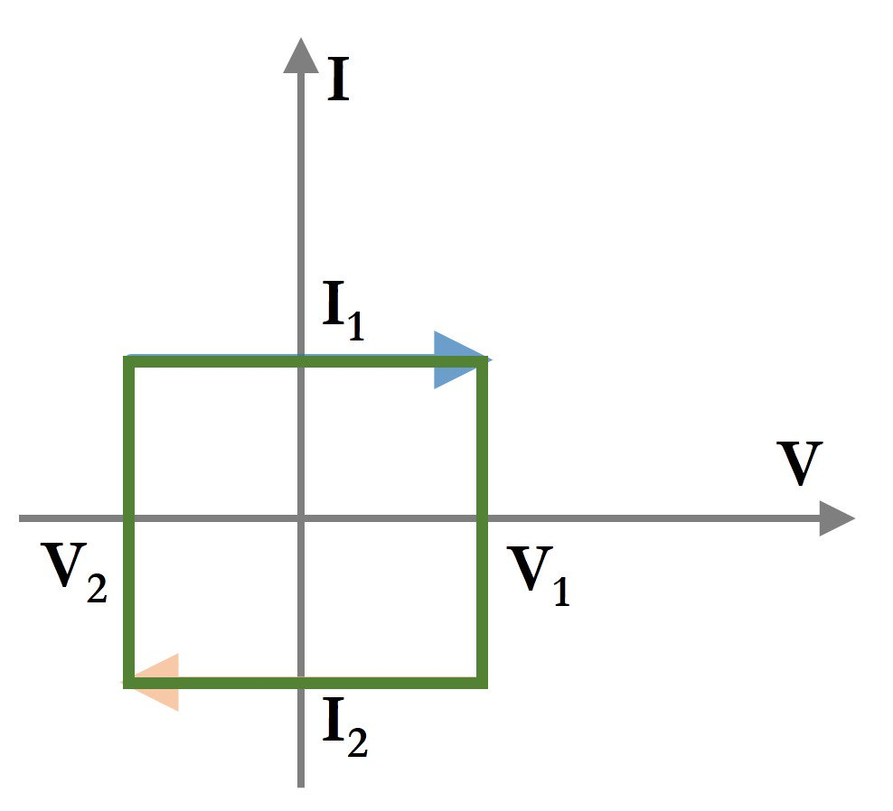
For Capacitors
A capacitor is physically made of two conducting surfaces separated by an insulator. In an electrical circuit capacitors have both a steady state and transient effect on the circuit.
As the electrical conductors are not in physical contact, it will not, in the long term pass direct current. The action is the same as placing a boat paddle against a stream of water – it blocks current flow. However when voltage is first applied to a capacitor current will flow until the capacitor is charged. This is a transient effect.

Slide 16
TYPICAL NOTATIONS OF RESISTORS,INDUCTORS AND CAPACITORS

Slide 17
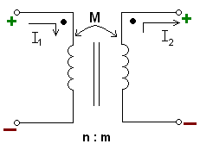
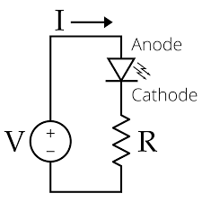
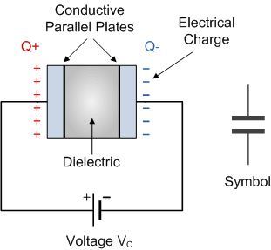
INDUCTORS
RESISTORS
CAPACITORS

Slide 18


